Slide 1


Martial Arts Gym Information and Tracking System (MAGITS)

Slide 2


Introduction
TeamBits
Members:
Aldrin John Jacildo
Sir Angel Naguit
Francis Victa
Maria Lillian Yang
Notes:
Script:

Slide 3

Martial Arts Gym Information and Tracking System
MAGITS
Web application that automates a business process of Martial Arts Gyms
It also solves common problems that the business face in their everyday operations
The project will:
Enable the gym to keep digital records of accounts and profiles
Monitor and manage membership types of students
Track student attendance and use modern QR code technologies to submit attendance
Allow Instructors to send important announcements
Notes:
Problems:
Manual information tracking
Physical data storage
No communication platform

Slide 4

MAGITS- In Scope
Session Management
admin instructor
Session Feedback Feature
admin instructor member
Login and Logout Feature
admin instructor member
Course Management
admin
Membership Type Management
admin
Instructor Management
admin
Member Account Management
admin instructor
Announcements Management
admin instructor

Slide 5

MAGITS - Out of Scope
Out of Scope:
Payment System
Inventory Management
Employee Management
Social Messaging
Payroll System
Notes:
Anghel

Slide 6
Mockup Demo

Slide 7




Technical Requirements
Database: MongoDB with Mongoose
Programming Language: TypeScript, Javascript
Runtime Environment: Node
Frontend Framework: Angular
Backend Framework: Express
Web Host: Heroku
Hardware: Mobile Phone, Laptop, Mobile Phone and Laptop Camera, PC
Coding Environment: Visual Studio Code
Repository: Github

Slide 8
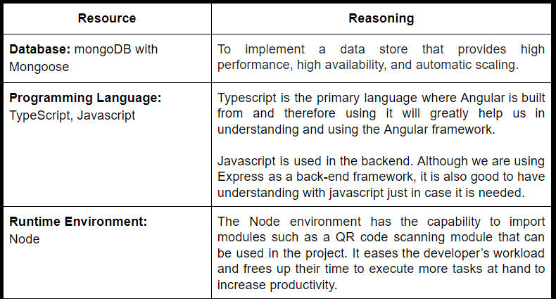
Technical Requirements

Slide 9
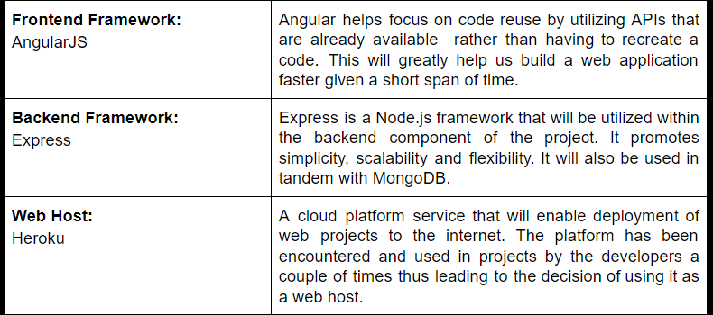

Technical Requirements

Slide 10
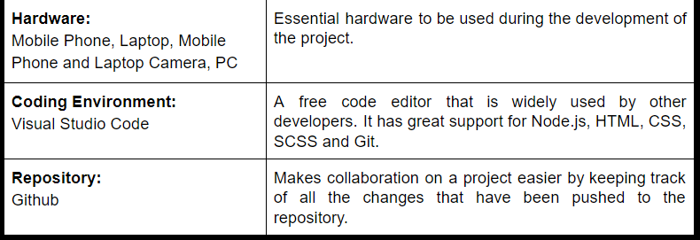


Technical Requirements

Slide 11
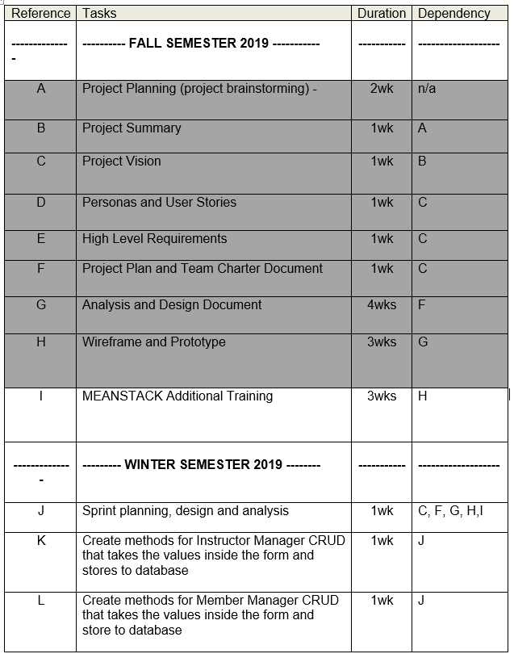


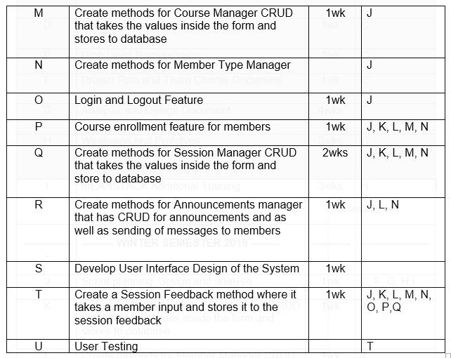
MAGITS Project Status

Slide 12

Conclusion(Next Steps)
Start with the Learning Plan and Additional Training (immediately)
Further Research and Experiment on QR Code Scanning Technologies
Experiment with UI Design
Enjoy the Holidays! :)

Slide 13


End of Presentation! :)

